Slide 1
CSE 130: IoT-1 TELEGRAM BOT WITH NODEMCU ESP8266 WIFI MODULE
1.E0121046-SwathySuresh / 1st year / AIML
2.E0121060-DhariniMurganandham/1st year /AIML
3.E0121027-Sivane Senthil/1st year/AIML

Slide 2
OBJECTIVE
Bots are third party applications that run inside telegram
Users can interact with bots by sending them messages. This interaction with the 3rd party using Arduino board.

Slide 3

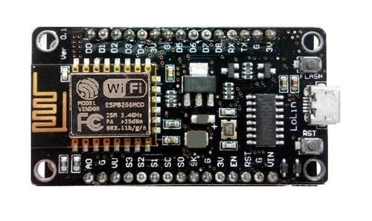
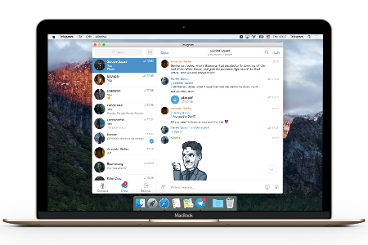

CIRCUIT CONNECTION

Slide 4
WORKING
To interact with the Telegram bot, we’ll use the Universal Telegram Bot Library.
Go to Sketch > Include Library > Add.ZIP Library..
Add the library that just got downloaded.
Wifi information (name and password)
Telegram bot information (username)
Compile and upload the code with board.
The pc and Arduino are been connected using USB port.
Open Telegram on preferred device .
start a chat with a bot is /start, our Arduino will answer with a welcome message.

Slide 5
WORKING
Now type help (without slash), it will answer with a list of supported commands, you can try them all
You are done with the test, if something is not working, check the infomation entered in the sketch (name, username, token...)
Open Tools->Wifi101/wifinina updater
board (connected) then click open updater sketch and upload it to the board
After upload, in the updater choose the latest firmware for your board and click update firmware
After update, in the updater, section SSL certificates, click Add domain, in the dialog write telegram.org:443 then press OK.
Click Upload certificates to wifi module and Upload this sketch to the board
You can write a sub for each new command. Every sub will take care of completing the command and (eventually) return a status information to the user.

Slide 6
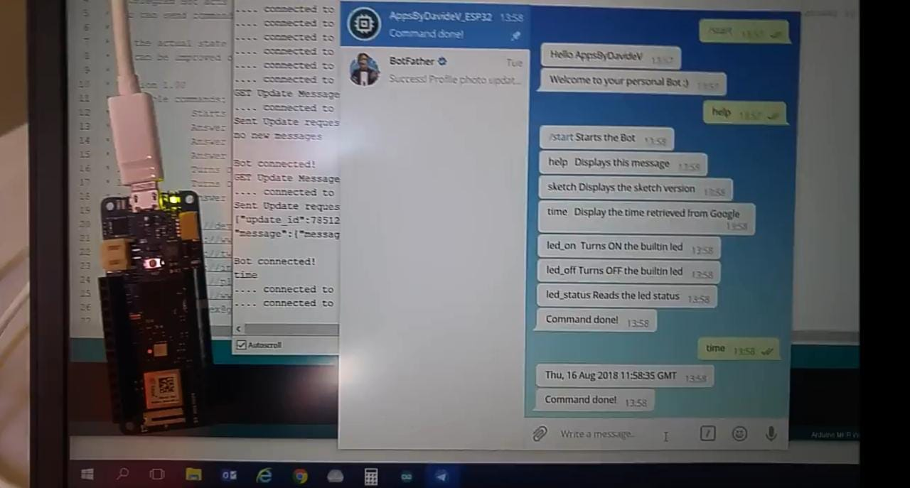
WORKING PROTOTYPE
USB
Telegram app
Arduino ide
Wifi
Arduino board

Slide 7
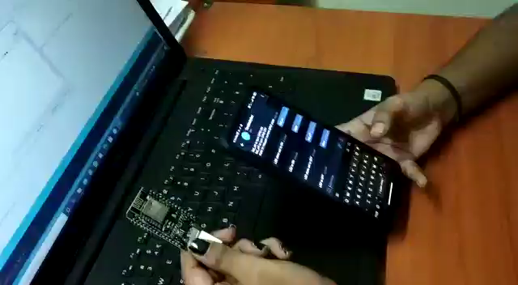
DEMO VIDEO

Slide 8
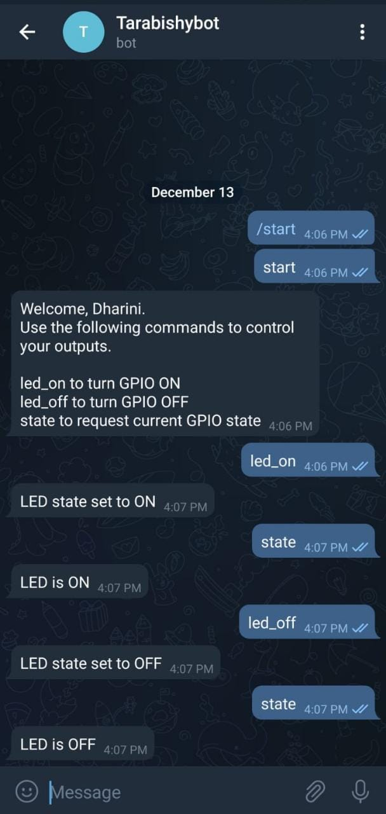
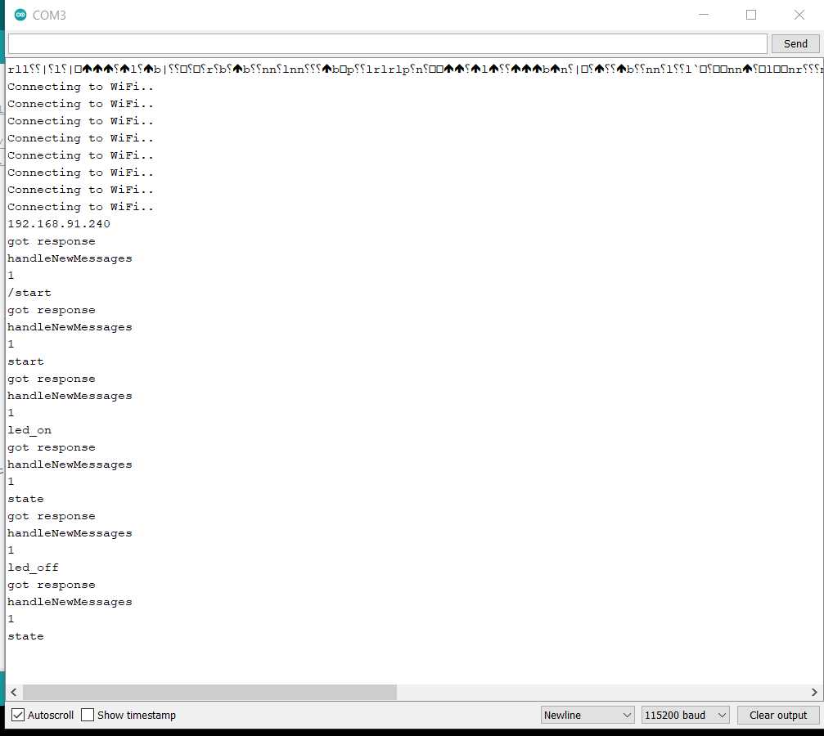

Slide 9
REFERENCES
https://create.arduino.cc/projecthub/Arduino_Genuino/telegram-bot-library-ced4d4
https://www.toptal.com/python/telegram-bot-tutorial-python
https://core.telegram.org/bots
https://riptutorial.com/telegram-bot/example/25075/create-a-bot-with-the-botfather
https://randomnerdtutorials.com/telegram-control-esp32-esp8266-nodemcu-outputs/

Slide 10
THANK YOU !!!!

